Slide 1
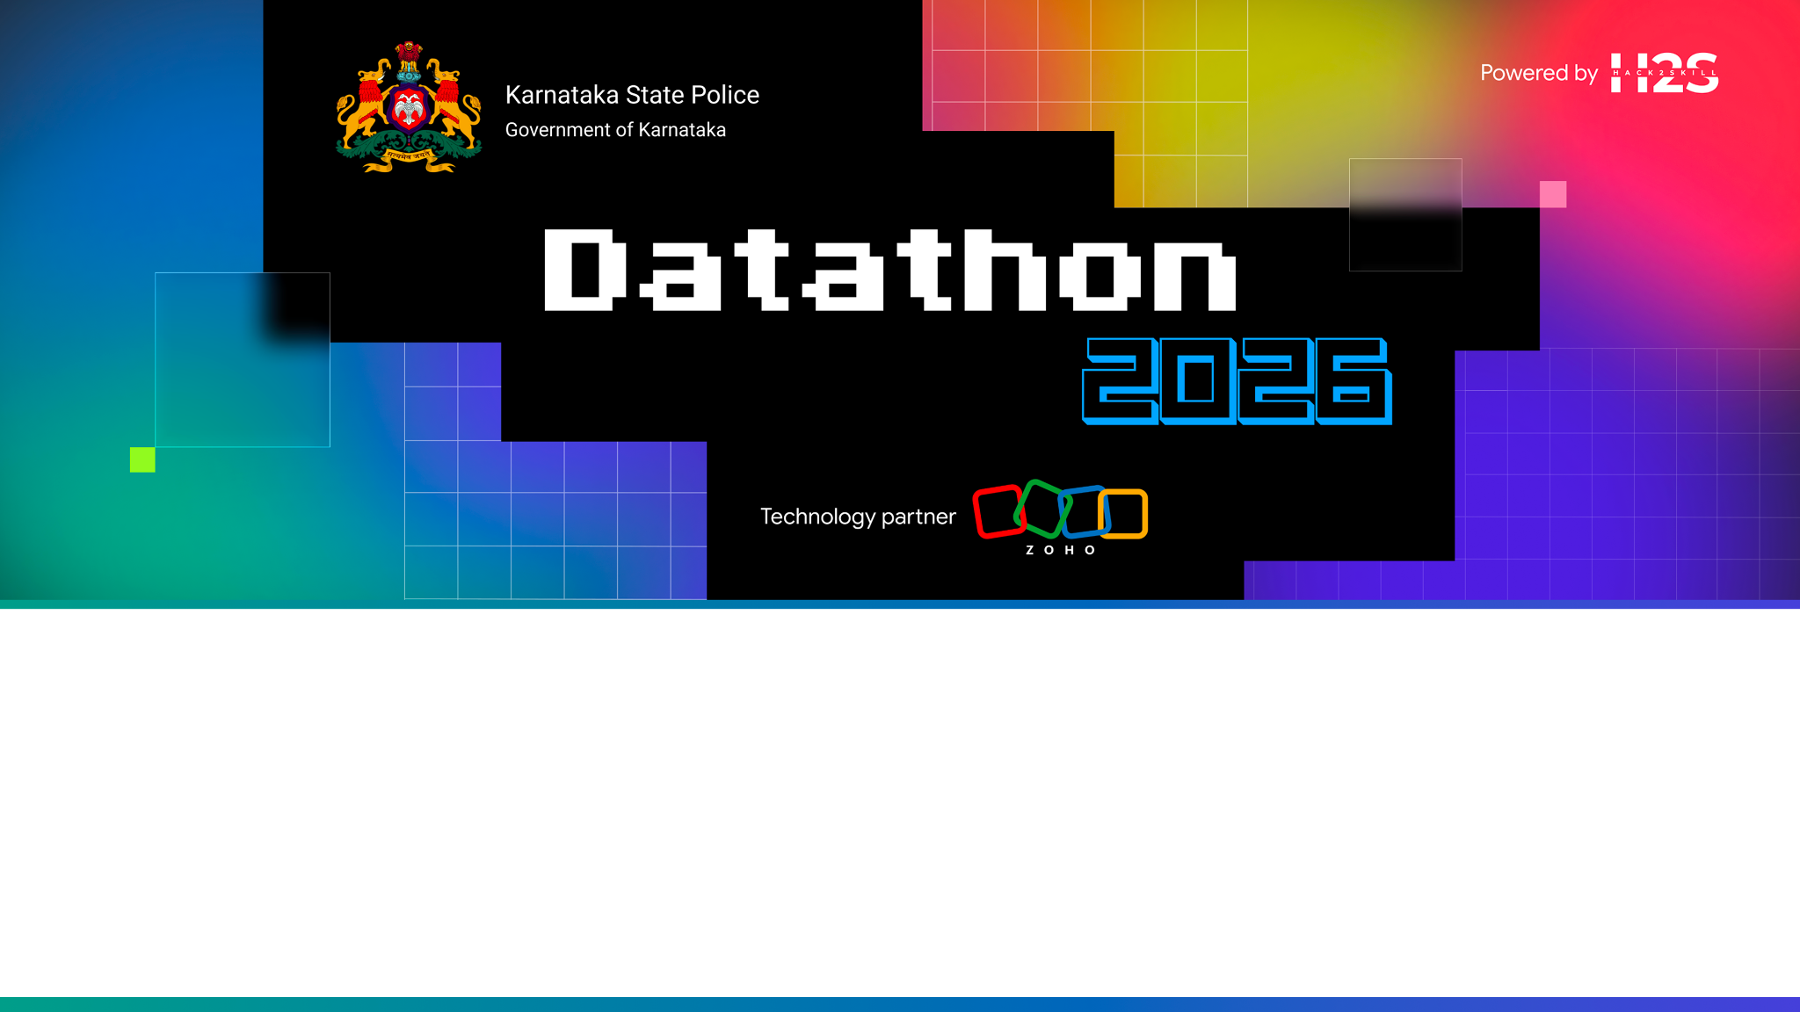
Team name: Crime Craft
Team leader name: Jayant Agarwal
Team size: <fill in>
Problem Statement:
Citizens and KSP officers lack a fast, safe way to query the state's case corpus. Crime Craft is a multilingual (EN / HI / KN), role-aware conversational AI over KSP case data: citizens get redacted public answers; officers get full case context, analytics, criminal-network views and gated, explainable predictive signals — every access PII-safe and audit-logged.

Slide 2
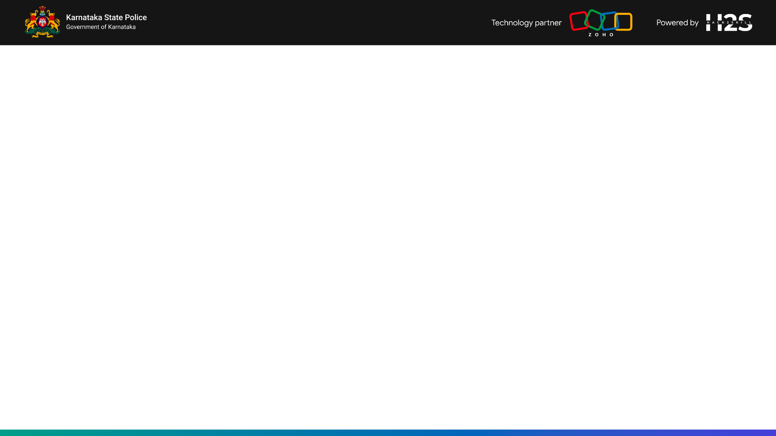
Brief about the solution
Crime Craft turns KSP's case records into answers — a chat-first, multilingual intelligence layer for citizens and police.
• Ask in natural language (text or voice); answers are grounded in real case records via Retrieval-Augmented Generation (RAG) and cite their source FIR / case IDs — no hallucinated facts.
• One backend, two audiences: citizens see strictly redacted public info; officers & senior officers get full dossiers, analytics, network graphs and predictive tools — enforced at a single access chokepoint.
• Privacy-first & governed: PII (names, Aadhaar, phone, addresses) redacted at ingest; every request audit-logged; DPDP-aligned data classification.
• Not a model trained from scratch — RAG over a hosted LLM keeps it accurate, low-cost and fast to ship over a small corpus.
• Cloud-native on Zoho Catalyst (auth, datastore, hosting, cron) — already deployed and demoable.

Slide 3
Opportunities
How different is it from any of the other existing ideas?
How will it be able to solve the problem?
USP of the proposed solution
How different from existing ideas
• Existing tools are static dashboards or keyword FIR search. Crime Craft is conversational, grounded, multilingual and role-aware in one interface.
• Every answer cites its source case IDs (traceable, not a black box); the SAME pipeline serves public + police with different visibility — no parallel apps or hand-written per-route checks.
How it solves the problem
• Cuts officer context-assembly from hours to seconds; gives citizens safe, redacted self-service on trends & case status; auto-surfaces hotspots, trends and criminal-network links.
USP of the proposed solution
• RAG-grounded answers with citations + PII redaction at ingest + full audit trail + explainable (SHAP) predictive scoring — governance is built in, DPDP-aligned. Trilingual (EN/HI/KN), text + voice.

Slide 4
List of features offered by the solution
• Conversational RAG chat over the case corpus with source-case citations, in English / Hindi / Kannada.
• Voice in & out — Whisper speech-to-text + text-to-speech (read answers aloud).
• Role-based access — Public / Officer / Senior Officer / Admin — enforced at one chokepoint.
• Automatic PII redaction at ingest (names, Aadhaar, PAN, phone, vehicle reg., emails in free text).
• Analytics dashboard — crime trends, top localities and hotspots over a recent window.
• Interactive criminal-network graph linking cases and suspects (Cytoscape.js).
• Recidivism risk scoring — senior-only, XGBoost + SHAP, advisory-only and audit-logged with a mandatory reason.
• Full audit trail on every request; PDF export of conversations with a per-page traceable watermark.
• Hourly delta ingest via Catalyst Cron; automatic query-language detection.

Slide 5
Process flow diagram or Use-case diagram
Query flow: user query (text / voice) → auth + role resolve → role & PII-filtered retrieval (vector search over case chunks) → grounded LLM generation with citations → audit log → response with citation chips.
🖼 Insert process-flow / use-case diagram here

Slide 6
Wireframes/Mock diagrams of the proposed solution (optional)
A working prototype already exists — drop UI mockups or live screenshots of the citizen and officer views below.
🖼 Insert wireframes / UI mockups (or screenshots of the deployed app)

Slide 7
Architecture diagram of the proposed solution
React PWA → FastAPI gateway (RBAC + audit) → Chat/RAG · Analytics · Predictive services → Qdrant vector DB + Catalyst Datastore + ML models → hosted LLM + BGE-M3 multilingual embeddings. All on Zoho Catalyst.
🖼 Insert architecture diagram here

Slide 8
Technologies to be used in the solution
Frontend
• React + Vite + TypeScript + Tailwind CSS; Cytoscape.js (network graph); MapLibre (maps).
Backend
• FastAPI (Python), Pydantic, JWT auth + RBAC, audit middleware; ~120 offline tests.
AI / RAG
• Hosted LLM (Claude / OpenRouter); BGE-M3 multilingual embeddings; Qdrant vector DB; RAG with prompt caching + source citations.
Predictive & Voice
• XGBoost + SHAP (explainable recidivism); Whisper STT + Indic TTS.
Data / Privacy & Infra
• Regex + NER PII redaction; DPDP-aligned OPEN / SENSITIVE / PII classification; Zoho Catalyst (AppSail, Datastore, Auth, Cron, File Store); Docker; GitHub Actions CI.

Slide 9
List down Catalyst Services being used in the solution
• Catalyst AppSail — hosts the FastAPI backend and serves the React SPA (deployed as crime-craft-api).
• Catalyst Authentication — hosted login and officer user/role management.
• Catalyst Datastore — Cases, AuditLog, Conversations and CaseEmbeddings tables (queried via ZCQL).
• Catalyst Cron + Functions — hourly ingest job that pulls new case CSVs and runs the redaction pipeline.
• Catalyst File Store — inbox folder where KSP drops new case-data files for ingest.
• Roadmap — Catalyst QuickML / Zia as managed RAG & AutoML alternatives to self-hosting.

Slide 10
Estimated implementation cost (optional)
Indicative monthly run cost for a single-district pilot (finalise once Catalyst tier + LLM provider are locked):
• Zoho Catalyst (AppSail + Datastore + Auth + Cron): ₹ <tier-based> / month.
• Hosted LLM API (RAG, usage-based): low — RAG sends only small retrieved context; dev runs on free-tier / OpenRouter.
• Vector DB — Qdrant self-hosted on one small VM: ₹ <VM cost> / month.
• Embeddings — self-hosted BGE-M3: one-time corpus embedding on a VM, negligible thereafter.
• No model-training cost — RAG (not fine-tuning) is the single biggest saving vs a custom NLP build.

Slide 11
Snapshots of the prototype
Suggested screenshots: login & role pill · dashboard (trends / hotspots) · chat with citations (multilingual) · criminal-network graph · recidivism + SHAP · PDF export.
🖼 Dashboard — trends & hotspots
🖼 Chat with citations (EN/HI/KN)
🖼 Criminal-network graph
🖼 Recidivism + SHAP (senior view)

Slide 12
Prototype Performance report/Benchmarking
• ~120 automated tests, fully offline (no API keys) — CI-ready on every push.
• 18 REST endpoints, each role-gated where appropriate (OpenAPI auto-documented at /docs).
• RAG latency = one vector retrieval + one grounded LLM call; prompt caching cuts repeat-query input cost by ~90%.
• PII redaction is deterministic and runs at ingest — never dependent on the LLM 'remembering' to redact.
• Runs on the seed corpus today (demo cases); designed to scale to 1100+ real KSP cases.
Insert measured latency / throughput numbers from production once benchmarked.

Slide 13
Provide links to your:
GitHub (public repository): https://github.com/jayant-01/crime-craft
Demo Video (3 minutes): <paste your demo video link here>
Deployed link: https://crime-craft-api-50043858253.development.catalystappsail.in

Slide 14
Additional Details/Future Development (if any)
• SSO integration with KSP's officer-ID system.
• Flip live providers: swap stubs for Qdrant + BGE-M3 + a production LLM (with India data-residency review; on-prem open model option).
• Bias-audit harness (false-positive parity across demographics) before recidivism scoring goes live.
• Streaming ingest; anomaly detection over the audit log.
• Path-finding queries on the criminal-network graph; predictive crime-trend forecasting.
• Independent academic + KSP ethics review sign-off before any predictive feature launches.

Slide 16
